Slide 1
Byzantine Generals Problem

Slide 2
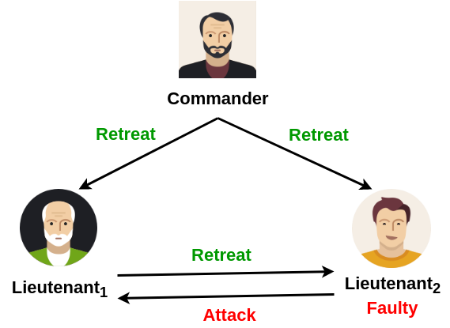
Three Byzantine Generals Problem: Lieutenant Faulty
Round1:
Commander correctly sends same message to Lieutenants
Round 2:
Lieutenant₁ correctly echoes to Lieutenant₂
Lieutenant₂ incorrectly
echoes to Lieutenant₁

Slide 3
Three Byzantine Generals Problem: Lieutenant Faulty
Lieutenant₁ received
differing message
By integrity condition, Lieutenant₁ bound to decide on Commander message
What if Commander is faulty??

Slide 4
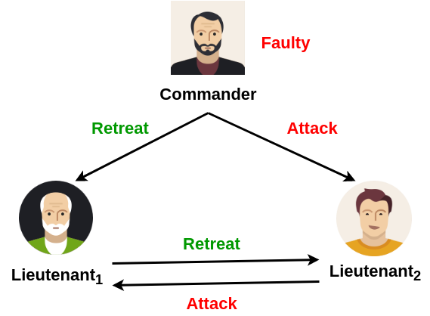
Three Byzantine Generals Problem: Commander Faulty
Round 1:
Commander sends differing message to Lieutenants
Round 2:
Lieutenant₁ correctly echoes to Lieutenant₂
Lieutenant₂ correctly echoes to Lieutenant₁

Slide 5
Three Byzantine Generals Problem: Commander Faulty
Lieutenant₁ received differing message
By integrity condition, both Lieutenants conclude with Commander’s message
This contradicts the agreement condition
No solution possible for three generals including one faulty

Slide 6
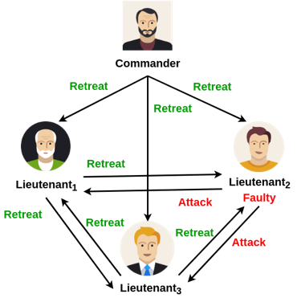
Four Byzantine Generals Problem: Lieutenant Faulty
Round 1:
Commander sends a message to each of the Lieutenants
Round 2:
Lieutenant₁ and Lieutenant₃ correctly echo the message to others
Lieutenant₂ incorrectly echoes to others

Slide 7
Four Byzantine Generals Problem: Lieutenant Faulty
Lieutenant₁ decides on majority(Retreat,Attack,Retreat)= Retreat
Lieutenant₃ decides on majority(Retreat,Retreat,Attack)= Retreat

Slide 8
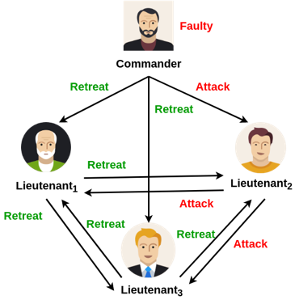
Four Byzantine Generals Problem: Commander Faulty
Round 1:
Commander sends differing message to Lieutenants
Round 2:
Lieutenant₁, Lieutenant₂ and Lieutenant₃ correctly echo the message to others

Slide 9
Four Byzantine Generals Problem: Commander Faulty
Lieutenant₁ decides on majority(Retreat,Attack,Retreat)= Retreat
Lieutenant₂ decides on majority(Attack,Retreat,Retreat)= Retreat
Lieutenant₃ decides on majority(Retreat,Retreat,Attack)= Retreat

Slide 10
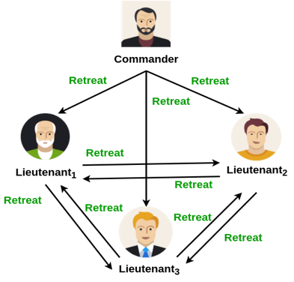
Byzantine Generals Model
N number of process with at most f
Faulty = 2f+1
Receiver always knows the identity of the sender
Fully connected
Reliable communication medium

Slide 11
Practical Byzantine Fault Tolerant Model

Slide 12
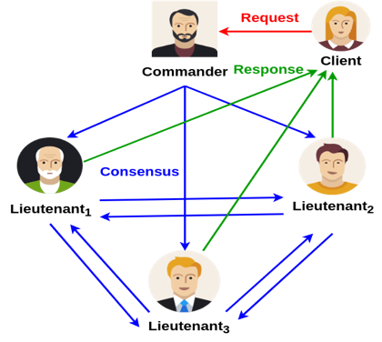
Practical Byzantine Fault Tolerant Model
Asynchronous distributed system
delay, out of order message
Byzantine failure handling
arbitrary node behavior
Privacy
tamper-proof message, authentication

Slide 13
Practical Byzantine Fault Tolerant Model
3𝑓+ 1 replicas are there where 𝑓 is the number of faulty replicas
The replicas move through a successions of configurations, known as
views
One replica in a view is primary and others are backups

Slide 14
Practical Byzantine Fault Tolerant Model
Views are changed when a primary is detected as faulty
Every view is identified by a unique integer number 𝑣
Only the messages from the current views are accepted

Slide 15
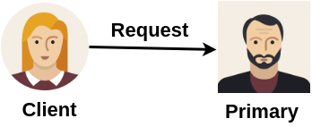
Practical Byzantine Fault Tolerant Algorithm
A client sends a request to invoke a service operation to the primary

Slide 16
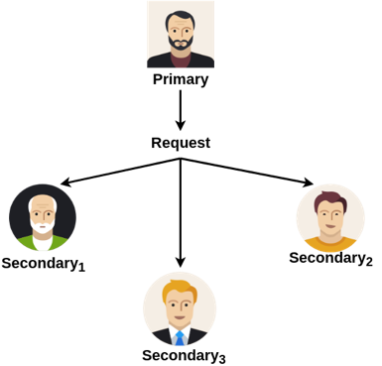
Practical Byzantine Fault Tolerant Algorithm
The primary multicasts the request to the backups/Secondary nodes

Slide 17
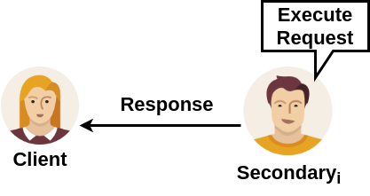
Practical Byzantine Fault Tolerant Algorithm
Backups execute the request and send a reply to the client

Slide 18
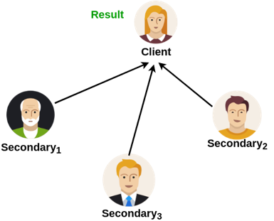
Practical Byzantine Fault Tolerant Algorithm
The client waits for 𝑓 + 1 replies from different backups with the same result
– 𝑓 is the maximum number of faulty replicas that can be tolerated

Slide 19
Three Phase Commit Protocol - Pre-Prepare
Pre-prepare: Primary assigns a sequence number 𝑛 to the request and multicast a message << 𝑃 RE−PREPARE , 𝑣 , 𝑛 , 𝑑 >_{𝜎_𝑝} , 𝑚 > to all
the backups
𝑣 is the current view number
𝑛 is the message sequence number
𝑑 is the message digest
𝜎_ p is the private key of primary - works as a digital signature
𝑚 is the message to transmit

Slide 20
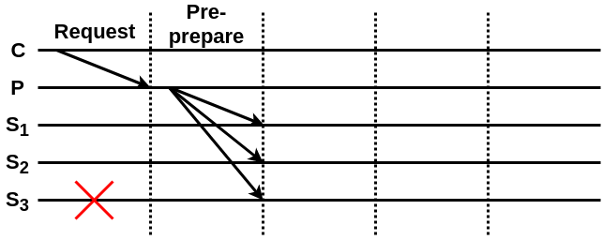
Three Phase Protocol
Pre-prepare:
– Acknowledge the request by a unique sequence number

Slide 21
Three Phase Commit Protocol - Pre-Prepare
Pre-prepare messages are used as a proof that request was assigned sequence number 𝑛 is the view 𝑣
A backup accepts a pre-prepare message if
The signature is correct and 𝑑 is the digest for 𝑚
The backup is in view 𝑣
It has not received a different PRE-PREPARE message with sequence 𝑛 and view 𝑣 with a different digest
The sequence number is within a threshold

Slide 22
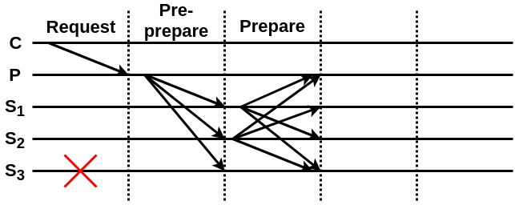
Three Phase Protocol
Prepare:
– Replicas agree on the assigned sequence number

Slide 23
Three Phase Commit Protocol - Prepare
If the backup accepts the PRE-PREPARE message, it enters prepare phase by multicasting a message < 𝑃 R E P A R E , 𝑣 , 𝑛 , 𝑑 , 𝑖 >_{𝜎_𝑖} to all other replicas
A replica (both primary and backups) accepts prepare messages if
Signatures are correct
View number equals to the current view
Sequence number is within a threshold

Slide 24
Three Phase Commit Protocol
Pre-prepare and prepare ensure that non-faulty replicas guarantee on a total order for the requests within a view
Commit a message if
2𝑓 prepares from different backups matches with the corresponding pre-prepare
You have total 2𝑓 + 1 votes (one from primary that you already have!) from the non-faulty replicas

Slide 25
Three Phase Commit Protocol
Why do you require 𝟑 F+𝟏 replicas to ensure safety in an asynchronous system when there are F faulty nodes?
If you do not receive a vote
The node is faulty and not forwarded a vote at all
The node is non-faulty, forwarded a vote, but the vote got delayed
Majority can be decided once 2𝑓 + 1 votes have arrived - even if 𝑓 are faulty, you know 𝑓 + 1 are from correct nodes, do not care about the remaining 𝑓 votes

Slide 26
Three Phase Commit Protocol - Commit
Multicast <COMMIT, 𝑣 , 𝑛, 𝑑, 𝑖 >_{𝜎_𝑖} message to all the replicas including primary
Commit a message when a replica
Has sent a commit message itself
Has received 2𝑓 + 1 commits (including its own)

Slide 27
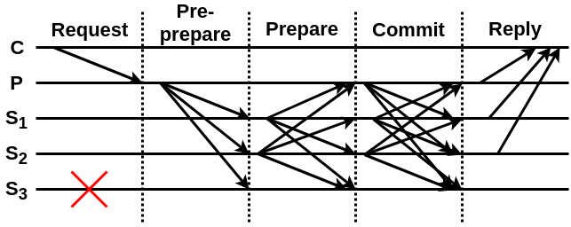
Three Phase Protocol
Commit:
– Establish consensus throughout the views

Slide 28
View Change
What if the primary is faulty??
non-faulty replicas detect the fault
replicas together start view change operation

Slide 29
View Changes
View-change protocol provides liveness
Allow the system to make progress when primary fails
If the primary fails, backups will not receive any message (such as PRE_PREPARE or COMMIT) from the primary
View changes are triggered by timeouts
Prevent backups from waiting indefinitely for requests to execute

Slide 30
Practical Byzantine Fault Tolerant
Why Practical?
Ensures safety over an asynchronous network Byzantine Failure
Low overhead
Real Applications
Tendermint
IBM's Openchain
ErisDB
Hyperledger

